Slide 1
Essentials of Generative AI
Notes:
Welcome to the world of Generative AI! Let's uncover the foundational elements that power creativity and innovation in artificial intelligence.

Slide 2
Getting Started with GenAI
Notes:
Lesson Namelet's begin our journey into Generative AI.

Slide 3
Why do you think generative AI is causing such a disruption across various industries when AI technology has been around for years?
Notes:
Mode: Sync
Estimated duration: 10 mins
Type: Instructor-led whole group discussion
Instructor Note:
Facilitate a whole group discussion to kick off today’s lesson. Ensure that you do not spend much time discussing the answers. This slide aims to gain the learners’ attention and relate the lesson theme with relatable examples before starting with the actual lecture topic.
Ask the learners to reflect on and discuss “Why do you think generative AI is causing such a disruption across various industries when AI technology has been around for years?”. The aim is to make the learners relate to the efficiency and potential of Generative AI before delving into the specific lecture topics.
You can use the example of a marketing company, who aims to boost their productivity, traditionally spends considerable time creating X number of posts in a day, sets the stage. Drive the discussion Highlight how Generative AI tools can help increase the productivity

Slide 4
Identify the applications of GenAI in solving real-world problems
Create prompts to communicate effectively with Gen AI tools for desired outcomes
Apply GenAI tools to create personalized documents such as resumes or conduct research
Use powerful GPTs, such as Write For Me, Canva AI, DesignerGPT, Consensus, and Universal Primer, to explore diverse Gen AI capabilities for various tasks
Notes:
By the end of this lesson, you'll be able to apply GenAI tools effectively and understand their practical applications.

Slide 5
Introduction to Generative AI
Notes:
Let's start with the basics of Generative AI and understand its core concepts.

Slide 6
Evolution from AI to Generative AI
This timeline visually represents significant milestones in the field of artificial intelligence.
ELIZA Chatbot
LSTM
GPT series
1950
1980
2014
Transformer
2018
LLM
Turing test
Neural network
GRU and Attention mechanism
2020 - Present
1966
1997
2017
Notes:
Trainer Note:
This timeline provides a visual representation of significant milestones in the field of artificial intelligence, particularly related to the development of natural language processing and generative models.
1950 - Turing Test: Developed by Alan Turing, this was one of the first attempts to define intelligent behavior in machines. A machine passes the test if it can exhibit human-like responses indistinguishable from a human to a judge.
1966 - ELIZA Chatbot: Created by Joseph Weizenbaum, ELIZA was one of the first chatbots and language processing programs. It mimicked conversation by using pattern matching and substitution methodology, giving users an illusion of understanding, but it had no built-in framework for contextualizing events.
1980 - Neural Network: The resurgence of neural networks in the 1980s (after initial interest in the 1950s and a period of stagnation) marks the period when these systems started to become a foundational tool for machine learning and AI.
1997 - LSTM: Long Short-Term Memory networks are a type of recurrent neural network capable of learning long-term dependencies. LSTMs were a significant advancement because they could remember information for extended periods, which was a major limitation of earlier neural networks.
2014 - GRU and Attention Mechanism: The Gated Recurrent Unit (GRU) is a simpler variation of LSTM that can also model long-term dependencies, with fewer parameters. The attention mechanism allows models to focus on different parts of the input sequentially, improving the performance of neural network-based models on tasks such as machine translation.
2017 - Transformer: This is a type of neural network architecture that, unlike RNNs, processes the entire input data simultaneously. The self-attention mechanism in Transformers allows the model to weigh the importance of different parts of the input data, which has significantly improved the performance of various NLP tasks.
2018 - LLM: Large Language Models like GPT (Generative Pre-trained Transformer) become prominent. These models, trained on vast amounts of text data, generate coherent and contextually relevant language and perform a variety of language-based tasks.
2020 - Present - GPT series: The GPT series, developed by OpenAI, showcases the evolution of LLMs with increasing sophistication and capabilities with each iteration, such as improved context understanding and generation of human-like text. The timeline indicates that the series has been ongoing since 2020, suggesting continuous development and possibly including models like GPT-4.

Slide 7
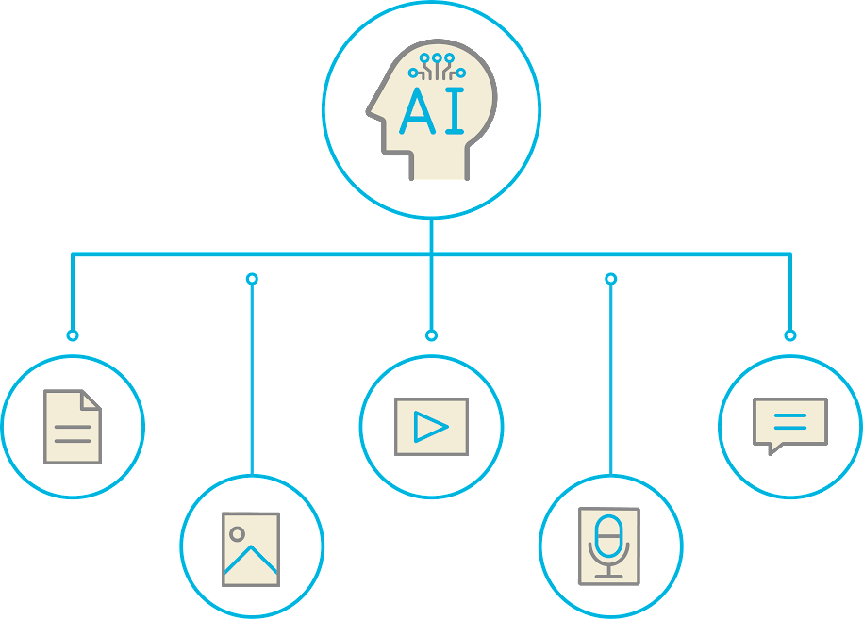
Generative AI
Generative artificial intelligence (GenAI) is a category of AI systems that focus on generating new content, such as images, text, music, or other forms of creative output.
It is a subset of artificial intelligence that leverages machine learning and deep learning techniques to generate data.
Notes:
In this slide, you can see various forms of content that Generative AI can generate, illustrating its wide-ranging applications. Whether it's crafting new music or generating realistic images, Generative AI is pushing the boundaries of what AI can achieve.

Slide 8

Objectives of Generative AI
It is designed to independently generate new content by deriving its structure from recognized patterns.
It assists with complex problem-solving by generating numerous potential solutions, thus offering users a wide array of options.
It boosts human creativity by producing unique outcomes, enabling users to discover new ideas and possibilities.
Notes:
Trainer Note:
This slide is self-explanatory.

Slide 9
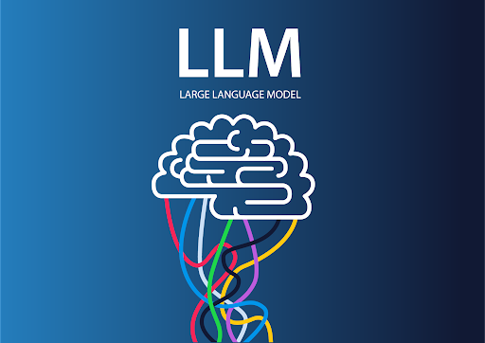
Generative AI and LLM
Large Language Models (LLMs) provide a foundation for generative AI by offering powerful, pretrained models capable of understanding and generating human-like text across various tasks and domains.
Generative AI can serve as building blocks for more advanced models, enabling the development of innovative AI systems that create content ranging from natural language text to images and music.
Notes:
Trainer Note:
This slide is self-explanatory.

Slide 10
Large Language Models(LLM)
LLMs are state-of-the-art AI models designed to comprehend and generate human language and perform natural language processing tasks like Translation, Classification, and so on.
Large
Refers to the significant size and complexity of these models, which contain hundreds of millions or even billions of parameters
Language
Denotes their primary function, which is to understand and generate human language
Describes them as mathematical representations that capture the patterns and structure of language data
Model
Notes:
Trainer Note:
As we explore the fascinating world of Generative AI, let's zoom in on one of its most impactful innovations: Large Language Models (LLMs). These Models are at the heart of how machines understand and generate human-like language, opening up a world of possibilities in communication and creativity.

Slide 11
Widely Used LLMs
Model | Developer | Key features
GPT 3.5/4 | OpenAI | It helps generate content, text summarization, sentiment analysis, data extraction, and language translations. The GPT 4 upgraded version bolsters multimodal capabilities, including the power to process different formats other than texts, like images and videos.
Gemini | Google | It aids in complex problem-solving and code generation.
Llama | Meta AI | It enables natural language understanding, content creation, and language translation.
Falcon | Technology Innovation Institute(TII) | It provides language translation, common-sense reasoning, and sentiment analysis.
Claude | Anthropic | It supports open-ended dialogues, coding tasks, and data analysis of visual inputs like charts and graphs.
Notes:
Trainer Note:
There are many Large Language Models (LLMs) available in the market. However, for this lesson, we will focus on using GPT for our experiments because it is extensively tested and adopted across various industries and applications. This widespread adoption means ample documentation, resources, and community support are available for users who choose to work with GPT.

Slide 12
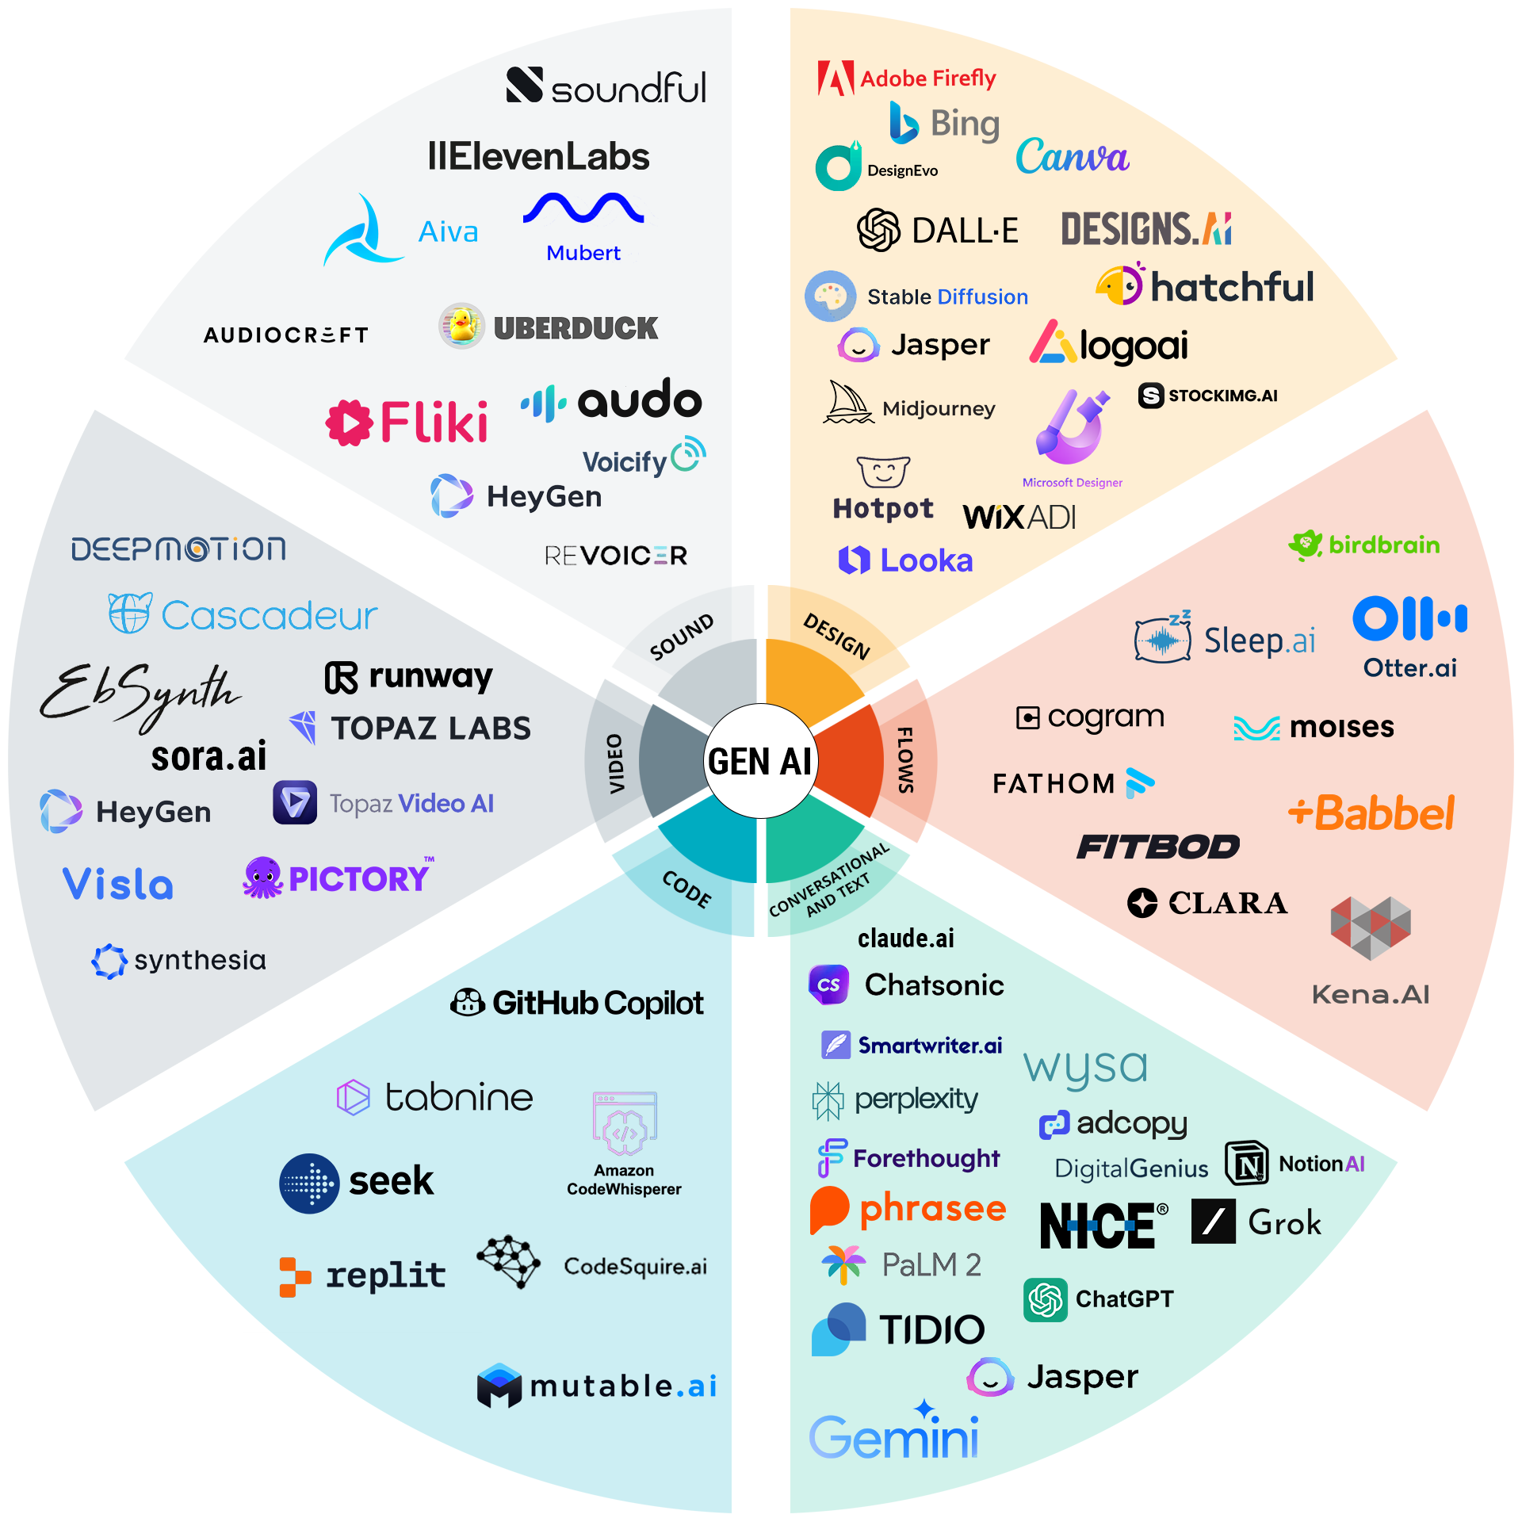
GenAI Tools
Top GenAI tools transforming various industries:
Notes:
Trainer Note:
These are the most popular tools used in different domains and in this course, we will cover at least one tool from each domain.
Although this image presents a variety of tools, there's no need to feel overwhelmed, all of these tools operate using a single language that is prompts. We'll delve into how to use prompts effectively in our next topic.

Slide 13
Resume and Cover Letter Creation Using ChatGPT
10
Learn how to create a resume and a cover letter using ChatGPT.
Imagine you have a resume ready, but you're unsure if it matches the job description you're applying for. Additionally, you're pressed for time to update it according to the job requirements.
In this scenario, how can you quickly and efficiently update your resume to align with the job description and save time?
Join us in a demonstration where we will use ChatGPT to help you quickly and effectively tailor your resume to the job description.
Note: Please download the demo documents from the LMS Reference Material Section for a detailed explanation.
Notes:
Instructor Note:
Please inform the learners to perform this demo and to see how prompts can help in getting the desired output.
Demonstrate the actions specified on the slide. Additionally, encourage the learners to actively participate by performing the tasks along with you during the demonstration.​
For further guidance, you can refer to the elaborated demo document.​
Guide the learners to download the demo documents available on the Learning Management System (LMS) under the section titled 'Reference Materials'.

Slide 14
As an intern at a tech company, you've been tasked with choosing an LLM for a project that requires generating highly accurate and factual content for technical documentation. Which of the following LLMs would be best suited for this purpose?
GPT-4
Gemini
Falcon
Claude
Notes:
Mode: Sync​
Estimated duration: 5 minutes​
Type: Poll Question​
Instructor Note:​
Conduct the poll and, if necessary, reteach key points based on the results before starting with the next topic.​
Provide feedback or explanations after the poll, where appropriate, so learners can understand why certain answers are correct or incorrect. ​
If most of the class is getting the poll incorrect, then there is a gap in their understanding. Prompt the learners to highlight which concepts are unclear to them and teach those topics for the understanding of the whole class. Move on to the next topic when the class is confident in their understanding of the section. ​
Correct Answer: B) Gemini - Trained extensively on a massive dataset of text and code for factual precision.
Explanation:
Gemini is explicitly tailored for factual precision, having been trained on a significant dataset of text and code, which makes it highly suitable for generating accurate technical documentation. While the other LLMs have their strengths—GPT-4 with its diverse features, Bloom with translation abilities, and Megatron-Turing NLG with its overall accuracy—Gemini’s training focus on factual information directly aligns with the requirements for producing precise technical content.

Slide 15
Understanding Prompts
Notes:
Let's learn how to effectively craft prompts for Generative AI.

Slide 16




What Is a Prompt?
A prompt is a natural language text that instructs generative AI models to perform a specific task.
Here are some key reasons why prompts are essential:
A precise prompt can lead to a more focused and useful output.
A well-crafted prompt guides the GenAI to understand the context and the specific requirements of the task at hand.
The prompt serves as a bridge between the user's intent and the AI's execution.
Notes:
Trainer Note:
Think of a prompt as a way to guide these powerful language models, much like how a teacher gives instructions to a student. For instance, when you ask Siri or Alexa a question, your question is a prompt that tells the AI what kind of response you're looking for. With the right prompts, we can unlock the full potential of LLMs in various applications. Now, let's delve deeper into the world of prompts and explore their types.
A prompt, in the context of AI interactions, is a specific input or instruction given to an AI model to elicit a response or output. This could be a question, a statement, a set of instructions, or even a piece of code, depending on what the user needs from the AI. The purpose of a prompt is to guide the AI in generating a response that is aligned with the user's intentions. Prompts are the fundamental means of communication between humans and AI models, telling the model what is being requested without direct programming.

Slide 17
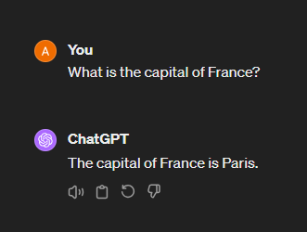
How Prompts Work?
When you give a prompt to a language model, it generates a response based on the patterns and information it has learned during its training.
Here's a simple example:
Here, the prompt is a straightforward question, and the language model provides an answer based on its training data.
Prompts can also be more complex and used for various tasks such as text completion, translation, summarization, and even creative writing.
The effectiveness of the response often depends on how well the prompt is crafted.
Notes:
Trainer Notes:
Open ChatGPT and showcase how prompt works

Slide 18
Important Components of a Prompt
Four important components that make up a great prompt are as follows:
Task
Instructions
Context
Input
Background information or situation that surrounds a task
Specific action or process
Rules to follow to achieve the desired outcome
Images, text, and dataset
Notes:
Task: The task is what the AI is trained to do when given a specific request. It could be anything from answering a question to creating something like a picture, story, or music.
For example, the task might be to write a social media post about building a brand.
Instructions: Instructions are like a guide for the AI. They tell it what it needs to do and how to do it. Instructions can include what to include in the content, what to avoid, and the steps to follow to complete the task.
For example, instructions for a social media post might say it has to be written in the first person and be at least 500 words long.
Context: Context gives the AI background information to better understand what you want. It can be examples, images, or ideas that help the AI know what kind of response you're looking for.
For example, providing context might tell the AI that the social media post is for influencers and is about improving their public image.
Input: Inputs are what you give the AI to work with. They may or may not be necessary for the desired output. Inputs could include images for editing, text for generating responses, or other types of data.
For example, you might give the AI a bunch of text files to help it generate a response.

Slide 19
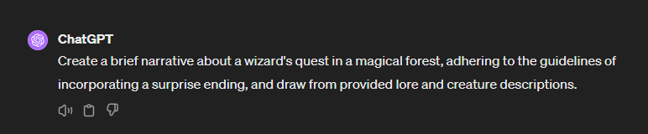
Important Components of a Prompt: Example
Consider the below example to understand the important components of a prompt better:
Task:
Create a brief narrative.
Instructions:
The story must involve a wizard's quest and include a surprise ending.
Context:
The narrative is set in a magical forest, with the protagonist on a quest.
Input:
Use the provided lore and descriptions of creatures within the forest.
Notes:
Trainer Note: This slide is self-explanatory.

Slide 20
Which component should be included in a prompt for a language model to translate a technical document from English to French?
Specify the source and target languages in the instructions.
Use a dataset unrelated to the technical field of the document.
Exclude any background information about the document's content.
Include technical jargon without explanations.
Notes:
Mode: Sync​
Estimated duration: 5 minutes​
Type: Poll Question​
Instructor Note:​
Conduct the poll and, if necessary, reteach key points based on the results before starting with the next topic.​
Provide feedback or explanations after the poll, where appropriate, so learners can understand why certain answers are correct or incorrect. ​
If most of the class is getting the poll incorrect, then there is a gap in their understanding. Prompt the learners to highlight which concepts are unclear to them and teach those topics for the understanding of the whole class. Move on to the next topic when the class is confident in their understanding of the section. ​
Correct Answer:
Specify the source and target languages in the instructions
Explanation: When crafting a prompt for translation, it is essential to specify both the source and the target languages within the instructions. This clarity helps the language model understand the task requirements and produce an accurate translation, aligned with the desired outcome.

Slide 21
Hands-on with ChatGPT
Notes:
let's dive into some hands-on experience with ChatGPT

Slide 22
Day-to-Day Tasks ChatGPT Can Do
ChatGPT is adept at handling a multitude of complex tasks beyond mere conversation.
Here are a few notable examples:
LinkedIn profile creation
Language translation
Sentiment analysis
Notes:
This slide is self-explanatory.

Slide 23
Multilingual Book Translation Using ChatGPT
10
Demonstrate how to translate user reviews in various languages using ChatGPT.
Imagine you operate an online bookstore that is popular worldwide. You offer books in multiple languages to cater to a diverse, global audience. To expand your reach and provide readers with books in their preferred languages, you use ChatGPT for real-time book translation.
To explore this further, let’s consider a demonstration in which we'll utilize ChatGPT to facilitate the translation process and demonstrate its effectiveness in handling language barriers.
Note: Please download the demo documents from the LMS Reference Material Section for a detailed explanation.
Notes:
Instructor Note:​
Please demonstrate the actions specified on the slide. Additionally, encourage the learners to actively participate by performing the tasks along with you during the demonstration.​
For further guidance, you can refer to the elaborated demo document.​
Please guide the learners to download the demo documents available on the Learning Management System (LMS) under the section titled 'Reference Materials'.

Slide 24
LinkedIn Profile Creation Using ChatGPT
10
Demonstrate how to create an impressive LinkedIn profile using ChatGPT.
Imagine you're preparing to create your LinkedIn profile, but you're aiming for something more exciting by creating a personal brand.
Let's check out this demo, where we'll use the ChatGPT prompt to help make your LinkedIn profile awesome and stand out from the crowd!
Note: Please download the demo documents from the LMS Reference Material Section for a detailed explanation.
Notes:
Instructor Note:​
Please demonstrate the actions specified on the slide. Additionally, encourage the learners to actively participate by performing the tasks along with you during the demonstration.​
For further guidance, you can refer to the elaborated demo document.​
Please guide the learners to download the demo documents available on the Learning Management System (LMS) under the section titled 'Reference Materials'.

Slide 25
Sentiment Analysis of User Reviews Using ChatGPT
10
In this demo, we’re showcasing sentiment analysis with ChatGPT to distinguish between praises, complaints, and many other types of feedback.
Have you ever scrolled through tons of online reviews, wondering which ones are positive and which are negative? This can be time-consuming.
ChatGPT can instantly analyze the reviews and provide the percentage of positive and negative feedback.
Note: Please download the demo documents from the LMS Reference Material Section for a detailed explanation.
Notes:
Instructor Note:​
Please demonstrate the actions specified on the slide. Additionally, encourage the learners to actively participate by performing the tasks along with you during the demonstration.​
For further guidance, you can refer to the elaborated demo document.​
Please guide the learners to download the demo documents available on the Learning Management System (LMS) under the section titled 'Reference Materials'.

Slide 26
ChatGPT: Multimodal Capabilities
Notes:
Let's dive into the amazing Multimodal capabilities of ChatGPT.

Slide 27



ChatGPT: Multimodal Capabilities
The advanced version of the ChatGPT (ChatGPT – 4) model has multimodal capabilities that go beyond just text generation.
Text-to-speech/ Speech-to-text
Text/Document
Image
Note: ChatGPT has the capability to convert text-to-speech and speech-to-text in the mobile version.
Notes:
Multimodal AI refers to artificial intelligence capable of Processing and generating diverse data inputs concurrently, including text, images, videos, and audio.
While GPT-4 expands its attachment options to images, videos, and audio files, it's important to note that ChatGPT specifically cannot process or generate videos or audio as of date.

Slide 28
ChatGPT: Multimodal Capabilities
Integration of multiple modalities: Combines text, images, videos, audio, and more to understand and generate responses
Enhanced context awareness: Utilizes visual and auditory cues to provide more comprehensive and accurate answers
Dynamic and interactive responses: Enable a more natural and human-like conversation experience
Image captioning: Describes images using natural language
Video analysis: Extracts information from video content and responds accordingly
Virtual assistants: Offer image-based responses for enhanced assistance
Notes:
This slide is self explanatory.

Slide 29
Exploring Multimodal Capabilities of ChatGPT
10
Demonstrate how ChatGPT works beyond text.
In this demo, our objective is to delve into the realm of multimodal tasks, where ChatGPT will be equipped to handle both visual and textual inputs concurrently.
Through this endeavor, we aim to showcase the potential of ChatGPT in addressing complex multimodal tasks and advancing the capabilities of GenAI systems.
Note: Please download the demo documents from the LMS Reference Material Section for a detailed explanation.
Notes:
Instructor Note:​
Please demonstrate the actions specified on the slide. Additionally, encourage the learners to actively participate by performing the tasks along with you during the demonstration.​
For further guidance, you can refer to the elaborated demo document.​
Please guide the learners to download the demo documents available on the Learning Management System (LMS) under the section titled 'Reference Materials'.

Slide 30
Customer Feedback Analysis Using ChatGPT-4
10
Demonstrate how to use ChatGPT to categorize customer feedback into positive, negative, constructive, or neutral sentiments and visualize the results.
As a data analyst at a large e-commerce company, your task is to analyze the customer feedback collected after a major sales event. The objective is to identify areas of success and opportunities for improvement, thereby aiding the company in enhancing its future sales strategies.
To address this, let's explore a demo where we'll experiment with using ChatGPT prompts to tackle this issue.
Note: Please download the demo documents from the LMS Reference Material Section for a detailed explanation.
Notes:
Instructor Note:​
Please demonstrate the actions specified on the slide. Additionally, encourage the learners to actively participate by performing the tasks along with you during the demonstration.​
For further guidance, you can refer to the elaborated demo document.​
Please guide the learners to download the demo documents available on the Learning Management System (LMS) under the section titled 'Reference Materials'.

Slide 31
Explore Powerful GPTs
Notes:
Let's delve into the capabilities of powerful GPTs

Slide 32
Comparison between ChatGPT 3.5,4, and 4o
Here is a comparison highlighting key differences:
Feature | ChatGPT-3.5 | ChatGPT-4 | ChatGPT-4-turbo (4o)
Model size | Medium | Large | Large
Context length | Up to 4,096 tokens | Up to 8,192 tokens | Up to 128,000 tokens
Speed | Fast | Slower than 3.5 | Faster than 4
Use cases | General conversation, basic tasks | Complex tasks, nuanced understanding | Complex tasks, faster responses
Optimizations | Basic | Advanced | Turbocharged for efficiency
Multimodal capabilities | No | Yes | Yes
Notes:
This slide is self explanatory.

Slide 33
ChatGPT Comparison Based on a Use Case
Scenario: A researcher needs to summarize a 20-page research paper to identify key findings, methodologies, and conclusions.
Responses | ChatGPT-3.5 | ChatGPT-4 | ChatGPT-4-turbo (4o)
Summary quality | Provides a general summary but may miss some nuanced details | Produces a detailed and accurate summary, capturing nuanced details and methodologies | Matches the detail and accuracy of ChatGPT-4
Speed | Fast response | Slower compared to 3.5 | Faster than ChatGPT-4
Context handling | May struggle with longer context, requiring multiple prompts | Handles longer context better, providing a more cohesive summary | Handles very long context efficiently, making it ideal for summarizing lengthy documents in one go
Notes:
Trainer Notes: Let’s understand the responses and comparison of different ChatGPT models with the help of an example where a researcher is summarizing a 20-page research paper.
While ChatGPT-3.5 is good for basic summarization, ChatGPT-4 offers more detailed and accurate summaries. ChatGPT-4-turbo combines this detail with increased speed and efficiency, making it the best choice for tasks needing both depth and speed.

Slide 34
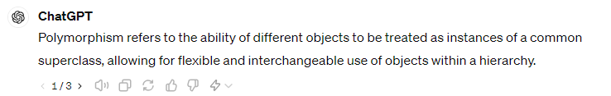
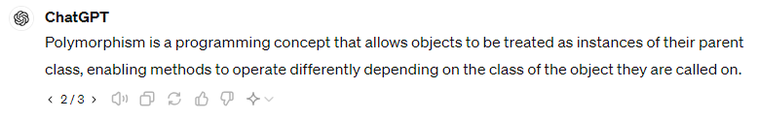
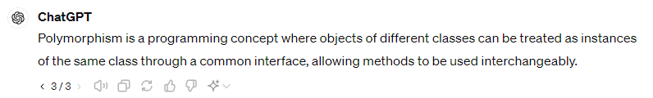
Comparison Based on a Prompt
Here are the responses from different ChatGPT models based on a single prompt.
Prompt: Explain polymorphism to me in a line
ChatGPT-3.5
ChatGPT-4
ChatGPT-4-turbo (4o)
Notes:
Trainer Notes: Each version provides a slightly different explanation of polymorphism, but all convey the fundamental idea of treating different objects through a common interface or superclass, enabling flexibility and interchangeable use in programming. 3.5 provides a basic explanation, 4 gives a more accurate response but a bit slower than 3.5, and 4o gives an accurate and faster response.

Slide 35





Explore GPTs: Categories of GPTs
The explore GPTs are custom GPTs accessible only with the GPT-4 version.
The Explore GPTs can be categorized in different ways, as shown below:
Writing
Education
Productivity
Research and analysis
Programming
Notes:
Instructor note:
In this topic, we will experiment with various other GPTs for the purposes mentioned above.

Slide 36
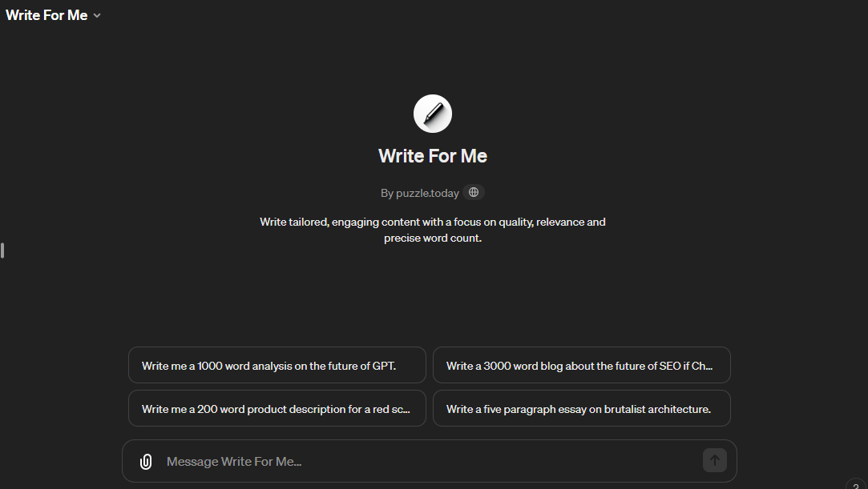
Writing GPTs: Write For Me
This GPT is focused on writing, such as content generation, writing assistance, or editing.
Write For Me is a personal writing assistant. It crafts tailored content, focusing on needs, audience, and SEO, ensuring ideas are transformed into engaging written material.
Notes:
Instructor note: The slide is self-explanatory.
You can refer to https://www.whatplugin.ai/gpts/write-for-me

Slide 37
The use of the Write For Me GPT for creating Marketing Content
10
In this demo, you will be able to illustrate the use of the Write For Me GPT for creating marketing content for an eco-friendly reusable water bottle, aiming to connect with environmentally conscious consumers.
The purpose is to demonstrate the application of GPT technology in creating engaging content that resonates with the target audience's environmental values.
Note: Please download the demo documents from the LMS Reference Material Section for a detailed explanation.
Notes:
Instructor Note:​
Please demonstrate the actions specified on the slide. Additionally, encourage the learners to actively participate by performing the tasks along with you during the demonstration.​
For further guidance, you can refer to the elaborated demo document.​
Please guide the learners to download the demo documents available on the Learning Management System (LMS) under the section titled 'Reference Materials'.

Slide 38
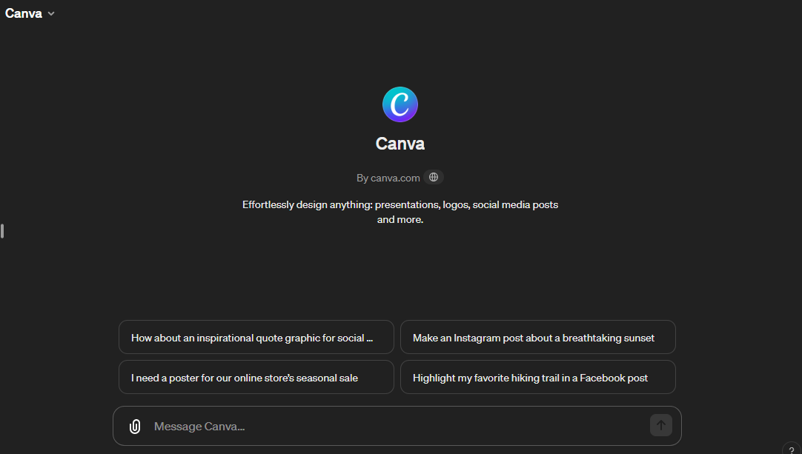
Productivity GPTs: Canva AI
This helps with increasing efficiency in tasks or workflows.
Canva AI makes designing easy by creating designs from your descriptions. Perfect for beginners and pros, it helps you make social media posts and presentations and turns text into images.
Notes:
Trainer note: The slide is self-explanatory.
You can refer to https://www.whatplugin.ai/gpts/canva

Slide 39
Creative Branding Makeover for Coffee Shops with Canva GPT
10
In this demo, you will be able to showcase Canva GPT's role in boosting productivity by designing appealing content for a coffee shop's new product, Sunrise Brew.
This demonstrates how GPT technology can streamline the design process and enhance marketing productivity.
Note: Please download the demo documents from the LMS Reference Material Section for a detailed explanation.
Notes:
Instructor Note:​
Please demonstrate the actions specified on the slide. Additionally, encourage the learners to actively participate by performing the tasks along with you during the demonstration.​
For further guidance, you can refer to the elaborated demo document.​
Please guide the learners to download the demo documents available on the Learning Management System (LMS) under the section titled 'Reference Materials'.

Slide 40
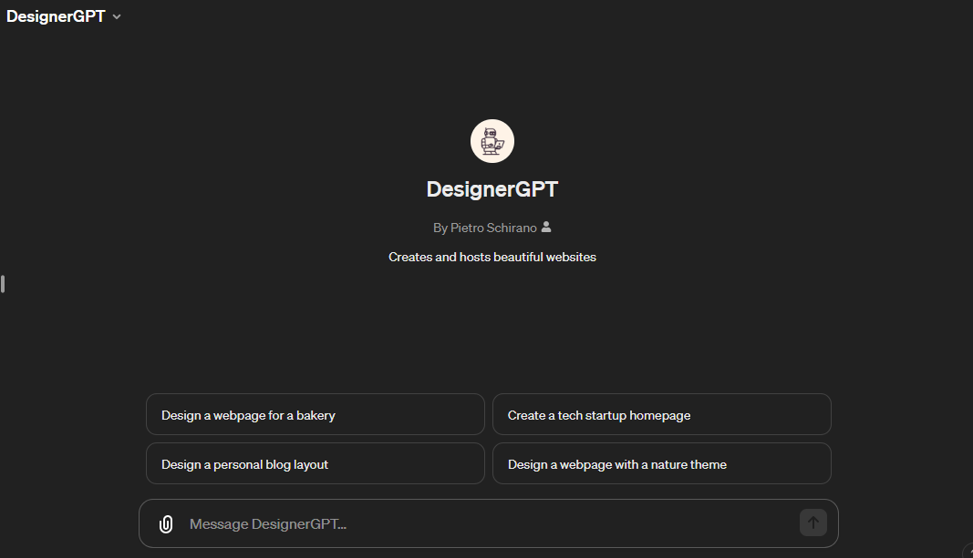
Programming GPTs: DesignerGPT
This helps with coding, such as automatic code generation, code reviews, or even educational tools for learning programming.
DesignerGPT is a specialized AI designed to instantly create and host beautiful, responsive HTML web pages tailored to user requests, streamlining web design with precision and efficiency.
Notes:
Trainer note: The slide is self-explanatory.
You can refer to https://www.whatplugin.ai/gpts/designergpt

Slide 41
Creating a Website Design Using DesignerGPT
10
In this demo, you will be able to use DesignerGPT to generate a visually appealing website design or product landing page for an online store, focusing on Programming GPT.
Note: Please download the demo documents from the LMS Reference Material Section for a detailed explanation.
Notes:
Instructor Note:​
Please demonstrate the actions specified on the slide. Additionally, encourage the learners to actively participate by performing the tasks along with you during the demonstration.​
For further guidance, you can refer to the elaborated demo document.​
Please guide the learners to download the demo documents available on the Learning Management System (LMS) under the section titled 'Reference Materials'.

Slide 42
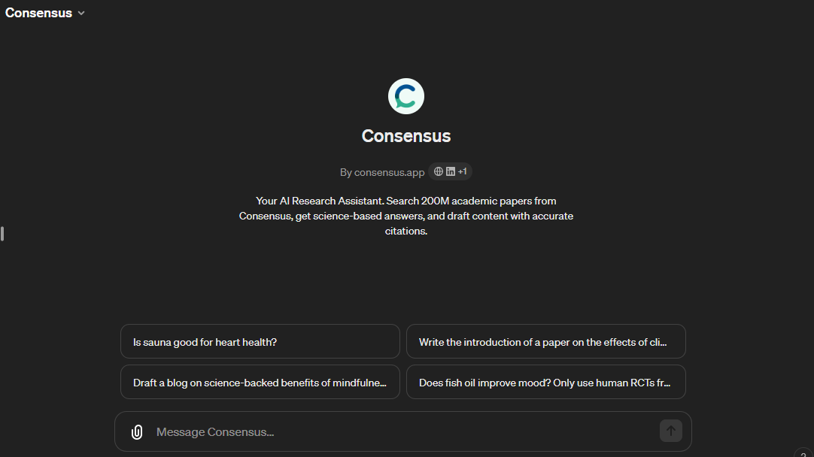
Research and Analysis GPTs: Consensus
This aids with research, data analysis, or information synthesis.
Consensus is a scientific research assistant leveraging AI to synthesize insights from academic papers, providing clear, concise summaries and evidence-based responses to your inquiries.
Notes:
Trainer note: The slide is self-explanatory.
You can refer to https://consensus.app/home/blog/accessing-the-consensus-chatgpt-plugin/

Slide 43
Streamlining Literature Surveys on LLM Impact with Consensus GPT
10
In this demo, you will be able to use the Consensus GPT for research and analysis to conduct a literature survey on the impact of Large Language Models (LLMs) on natural language understanding (NLU) tasks.
The goal is to gather recent studies on LLM advancements, particularly in question answering, text summarization, and sentiment analysis, and analyze key trends and challenges while highlighting the role of fine-tuning and transfer learning.
Note: Please download the demo documents from the LMS Reference Material Section for a detailed explanation.
Notes:
Instructor Note:​
Please demonstrate the actions specified on the slide. Additionally, encourage the learners to actively participate by performing the tasks along with you during the demonstration.​
For further guidance, you can refer to the elaborated demo document.​
Please guide the learners to download the demo documents available on the Learning Management System (LMS) under the section titled 'Reference Materials'.

Slide 44
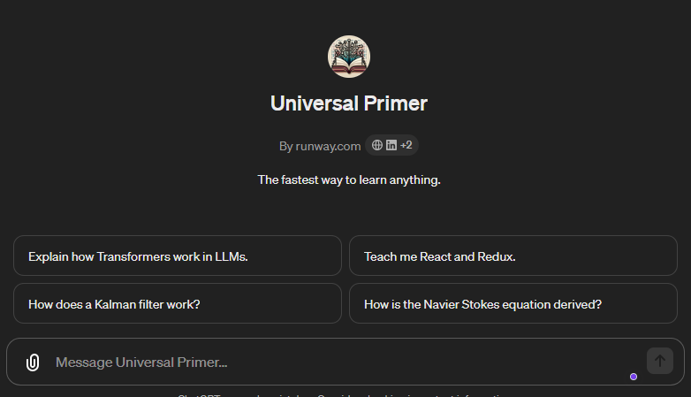
Education GPTs: Universal Primer
This encompasses GPT for teaching, tutoring, or creating educational content.
Universal Primer is the fastest way to learn everything about anything.
Notes:
Trainer note: The slide is self-explanatory.
You can refer to : https://www.whatplugin.ai/gpts/universal-primer

Slide 45
Enhancing Learning with the Universal Primer GPT
10
In this demo, you will be able to use the Universal Primer GPT to enhance educational content on chemical equilibrium for high school students.
The main goal is to demonstrate the Education GPT tool's ability to improve learning materials and help students understand complex concepts.
Note: Please download the demo documents from the LMS Reference Material Section for a detailed explanation.
Notes:
Instructor Note:​
Please demonstrate the actions specified on the slide. Additionally, encourage the learners to actively participate by performing the tasks along with you during the demonstration.​
For further guidance, you can refer to the elaborated demo document.​
Please guide the learners to download the demo documents available on the Learning Management System (LMS) under the section titled 'Reference Materials'.

Slide 46
GenAI is a subset of artificial intelligence that leverages machine learning and deep learning techniques to generate data.
LLMs can be classified in several ways, depending on their functions and users.
Prompts guide the GenAI to understand the context and specific requirements of the task.
GenAI tools perform tasks of various complexities, such as creating resumes, LinkedIn profiles, email classification, sentiment analysis, and other day-to-day tasks.
The multimodal capabilities of ChatGPT can simultaneously process and generate varied data types, such as text and images.
Notes:
Mode: Sync
Estimated duration: 5 mins
Type: Instructor-led activity
Instructor note:
Summarise the lesson.

Slide 47
Top Generative AI Tools: Boost Your Creativity
Notes:
Mode: async
Estimated duration: 2 mins
Type: Instructor-led
Instructor notes:
Please share the additional resource links in the chat with the learners.
https://oercommons.org/courseware/lesson/107793/overview

Slide 48
Notes:
Feel free to ask any questions you have. Let's clarify any doubts!
Estimated duration: 5 to 10 mins
Type: Whole-Group Activity

